Slide 1
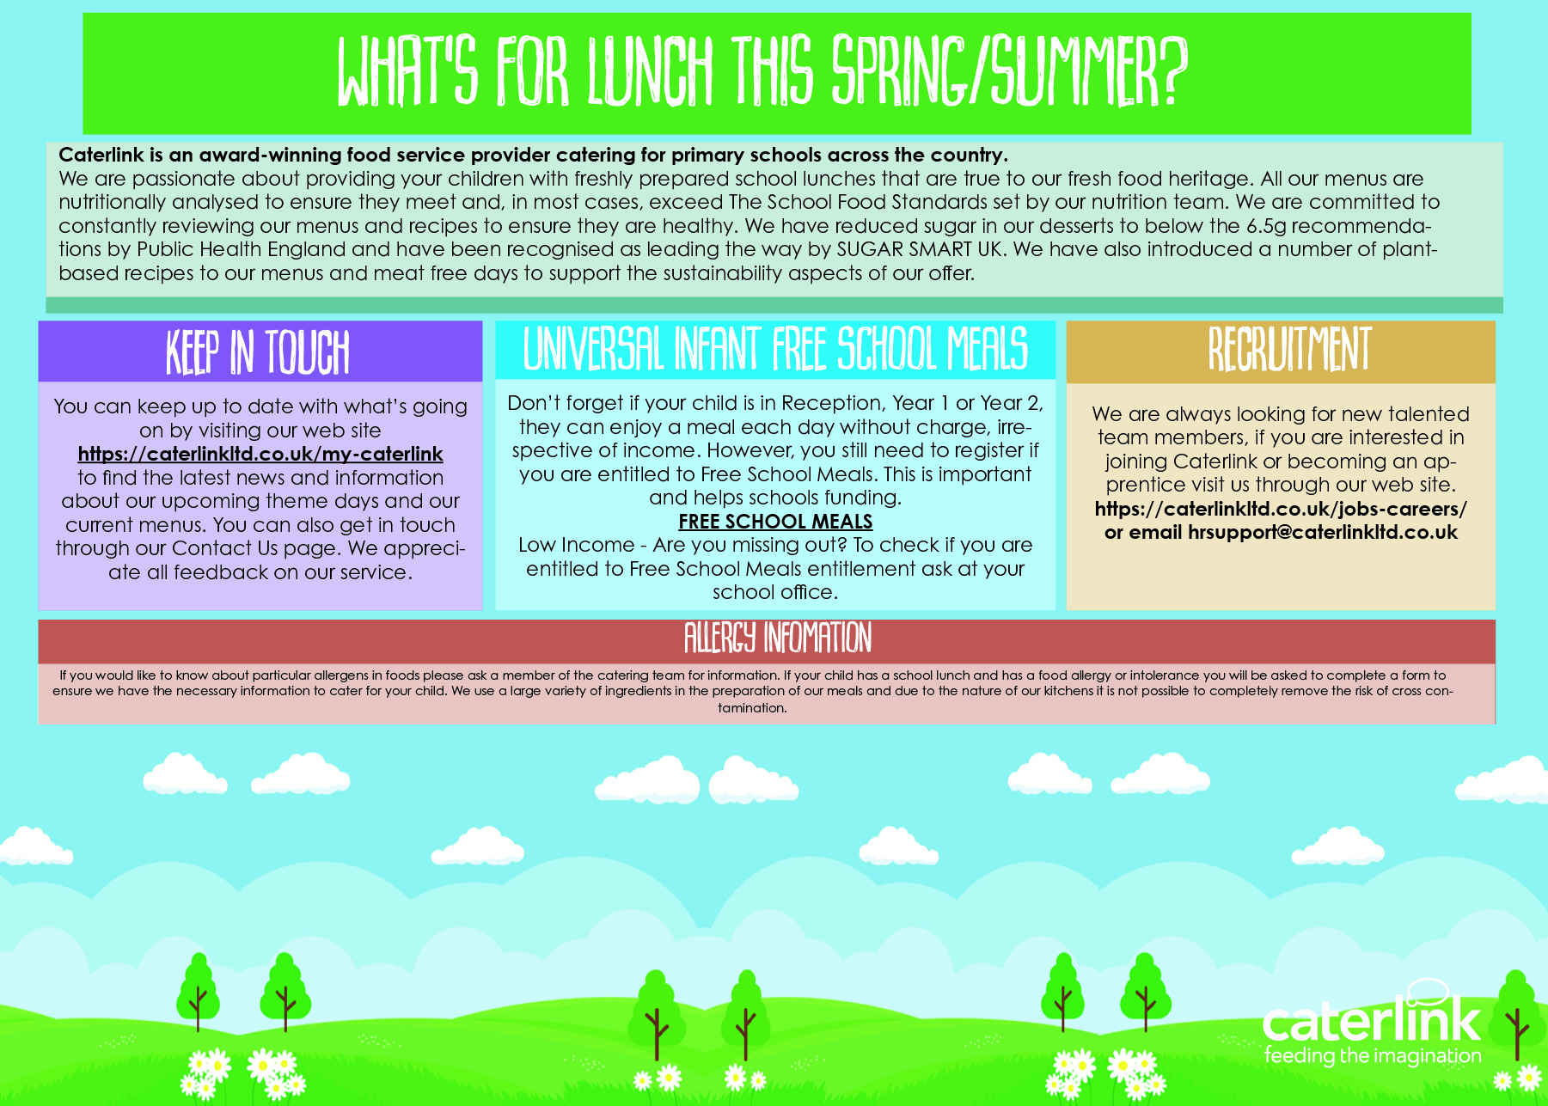

Slide 2
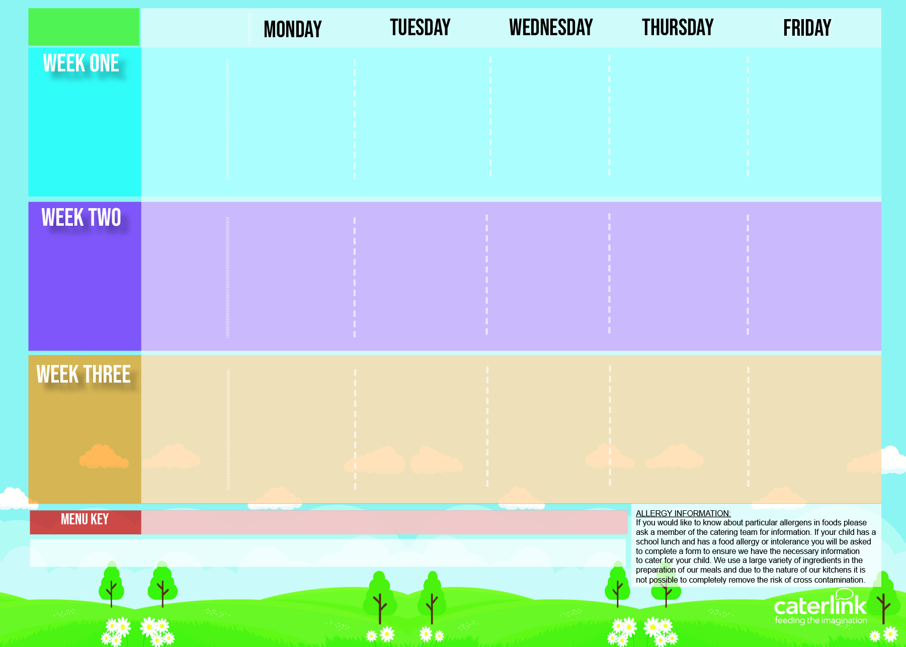




3 Choice Menu
Spring Summer 2025
Tomato and Lentil Pasta | Macaroni Cheese with Chicken Topping | Pork Sausage, Roast Potatoes & Gravy | Spaghetti Bolognaise | Fishfingers or Salmon Fishfingers with Chips & Tomato Sauce
Cheese and tomato pizza with salad Jacket Potato with Cheese or baked Beans | Macaroni Cheese Jacket Potato with Tuna Cheese or baked Beans | Roasted Quorn, Roast Potatoes and gravy Jacket Potato with Cheese or baked Beans | NEW Chickpea Curry with Rice Jacket Potato with Tuna, Cheese or baked Beans | Cheese & Bean Pasty with Chips & Tomato Sauce Jacket Potato with Cheese or baked Beans
Vegetables of the day | Vegetables of the Day | Vegetables of the Day | Vegetables of the Day | Vegetables of the Day
Apple Flapjack | Summer Lemon Cake | Fruit Platter | Savoury Cheese Scone | Strawberry Jelly with Mandarins
Option One
21st April 2025
12th May 2025
9th June 2025
30th June 2025
21st July 2025
15th September 2025
6th October 2025
Option Two
Option Three
Vegetables
Dessert
Option One
Lentil and Sweet Potato Curry with Rice | Pork or Chicken Hot Dog with Wedges & Tomato Sauce | Roast Chicken, Stuffing, Roast Potatoes, & Gravy | Chefs Special Chicken and Chickpea Korma with Rice | Battered Fish with Chips & Tomato Sauce
Cheese and tomato pizza with salad Jacket Potato with Cheese or baked Beans Vegetables of the day | Vegan Hot Dog with Wedges & Tomato Sauce Jacket Potato with Tuna, Cheese or baked Beans Vegetables of the day | Vegetable Soya Roast, Roast Potatoes & Gravy Jacket Potato with Cheese or baked Beans Vegetables of the day | Spaghetti &Meatballs Jacket Potato with Tuna, Cheese or baked Beans Vegetables of the day | Cheese and Tomato Quiche with Chips Jacket Potato with Cheese or baked Beans Vegetables of the day
Iced Vanilla Sponge | NEW Strawberry and Apple Crumble with Custard | Freshly Chopped Fruit Salad | Peaches and Ice Cream | Vanilla Shortbread
28th April 2025
19th May 2025
16th June 2025
7th July 2025
1st September 2025
22nd September 2025
13th October 2025
Option Two
Option Three
Vegetables
Dessert
Classic Vegan Bolognaise | NEW Green Thai Chicken Curry with Rice | Roast Turkey, Stuffing, Roast Potatoes & Gravy | NEW Greek Macaroni Pastitsio with Greek Salad and Tzatziki | Breaded Fish and Chips
Cheese and tomato pizza with salad Jacket Potato with Cheese or baked Beans Vegetables of the Day | NEW Chefs Special Five Bean Jollof Rice Jacket Potato with Tuna, Cheese or baked Beans Vegetables of the day | Veg Wellington, Roast Potatoes & Gravy Jacket Potato with Cheese or baked Beans Vegetables of the day | Spinach and Cheese Whirl with Rice, Greek Salad and Jacket Potato with Tuna, Cheese or baked Beans Vegetables of the day | All Day Vegetarian Breakfast Jacket Potato with Tuna, Cheese or baked Beans Vegetables of the day
Pear and cocoa upside down Cake | Cheese and Crackers | Fruit Medley | Jam and Coconut Sponge | Oaty Cookie
Option One
5th May 2025
2nd June 2025
23rd June 2025
14th July 2025
8th September 2025
29th September 2025
20th October 2025
Option Two
Option Three
Vegetables
Dessert
Added Plant Power
Lowest Carbon Footprint
Vegan
Chef’s Special
Available Daily: - Freshly cooked jacket potatoes with a choice of fillings - Bread freshly baked on site daily- Daily salad selection Yoghurt and fruit available daily

